Slide 1
Parent Night Incoming 11th/12th
Scheduling 2017/18

Slide 2
WELCOME!
Principals:
Mr. Willard
Mr. Billingslea – A-M
Mrs. Coe - North Campus
Mr. Johnson - P-Z
Counselor's:
Ms. Schaeff – North Campus
Mr. Conner - H-O (Early College)
Mrs. Lown – P-Z (Testing)
Mrs. Reichard – A-G (CACC)
Success Coordinators
Mrs. Lewicki
College Advisor- Karen Moore

Slide 3
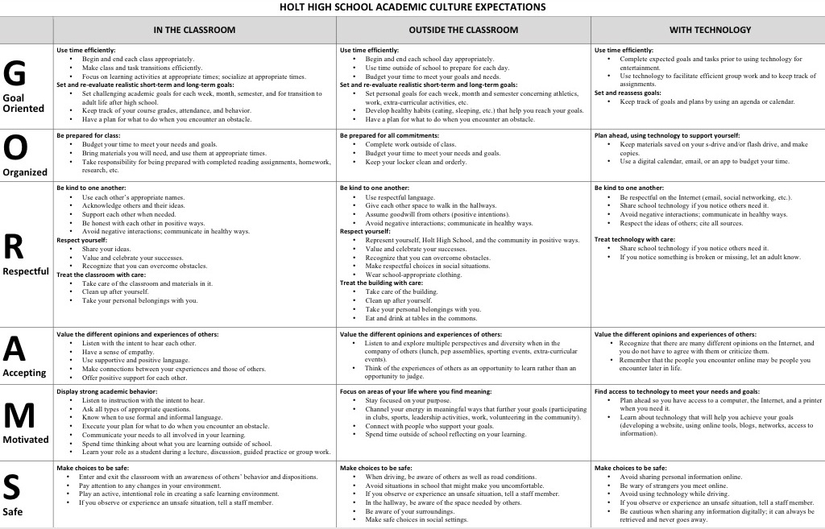
ACADEMIC CULTURE AT HHS

Slide 4
PROMOTING AN ACADEMIC CULTURE OF SUCCESS
Regular attendance is key! Those that miss more than 10% of classes are less successful (9 days a semester)
Advocate for yourselves. Check Skyward regularly, ask for help, take ownership of your learning, create goals for yourself, and make connections with your learning outside of class.
Come to class with the attitude to learn and participate.
Take rigorous courses that challenge you.

Slide 5
SAT
11th Graders-
SAT- April 11th
Work Keys- April 12th
M-Step- April 4/13 - 4/14

Slide 6
Parent Student resources
Parent Student Academic Resources
Kahn Academy
SAT Test Prep Workshop

Slide 7
Scheduling process

Slide 8
2016 and beyond 22 credits needed for Grad
9
10
11
12
1 | 2
Hist | Hist
Earth Sc | Earth Sc
Eng | Eng
Geom | Geom
1 | 2
Alg I | Alg I
W.H. | W.H.
Bio | Bio
Eng | Eng
1 | 2
Eng 11 | Eng 11
Alg II | Alg II
Gov
Chemistry/Phys | Chemistry/Phys
1 | 2
M.R | Eng Rel
Econ
Need two years of a Language (2016 +)

Slide 9
How do I make up credits
Summer School and Michigan Virtual High School are the options for making up credit when considered OFF TRACK for graduation. OFF Track = more than 2.0 credits of failure (5 classes)

Slide 10
2019 Course Request Sheet

Slide 11
11th Grade AP / Honors Courses
AP World History (10-12)- Application
Honors Math- Teacher recommendation/speak with instructor to get on list.
AP Government- Application
Honors English- 11- Application, (magazine rack on stairwell)
AP CPS- Application
All applications are due on March 3rd.

Slide 12
Mock Junior Schedule
hr | Semester 1 | Semester 2
1 | English 11 | English 11
2 | Algebra C | Algebra D
3 | Chemistry/Physics | Chemistry/Physics
4 | Government
5
6

Slide 13
College Planning Checklist- 11th
Keep meeting with your college/career counselor at least once a year
Continue to take and plan challenging courses
Keep your grades up
Join an academic club
We recommend taking the ACT, SAT will be the state mandated testing. Colleges will accept either.
Talk with your parents and high school counselor about colleges that interest you
Prepare a list of questions to ask on campus visits
Continue to visit colleges and talk with college students
List, compare, and visit colleges
Start or update an academic resume
Consider putting together a portfolio that highlights your special skills and talents
Keep filling out the college comparison worksheet (PDF; 1 page, 64KB)
Check into applying to colleges online
Investigate scholarship opportunities
Volunteer for activities and clubs related to career interests
Get a part-time job, apprenticeship, or internship; or job shadow in a profession that interests you
11th grade State required tests (SAT/WorkKeys/MSTEP)
Holt Public Schools students must complete all components of the SAT/WorKeys/MSTEP during their 11th grade year. In the event that a student does not take the State required test or took the exam and did not receive valid scores, the student is required to retake all required State tests in their 12th grade year, unless excused by the High School Administration.

Slide 14
NORTH CAMPUS
Principal: Michael Willard
Assistant Principal: Ann Coe
Building Secretary: Christine Lopez
Attendance Secretary: Joli Reinecke
Senior Counselor: Lindsay Schaeff
College Advisor: Karyn Moore

Slide 15
Counselor vs. college advisor
Counselor
Personal/social counseling
Graduation status
Transcripts to colleges
Senior year Scheduling
College Advisor
College Applications
Financial Aid (Scholarships, FASFA, grants)
College Support

Slide 16
2018 Course Request Sheet

Slide 17
Mock Senior Schedule
hr | Semester 1 | Semester 2
1 | English 12 | Math Related
2 | Economics
3
4
5
6
*STEM capstone will fulfill senior Math and English req. or Select separate Math and English ( e.g. Data Analysis/Intro to Poetry)

Slide 18
12th Grade AP / Honors Courses
AP World History (10-12)-application
AP Calc/Stats- 12
Recommended B or higher in previous year math
AP Lit (12th grade) no application needed
AP Econ- application-12
Chem II- 12 (must take Chem as a junior and pass with a B or higher)
All applications are due on March 3rd.

Slide 19
Math Related- Senior year
Fin. Insurance
Business Math
Computer Programming I and II
Accounting I and II
Web Publishing
Business Management
Promotional Marketing
Retail Management
Advanced Algebra
Virtual Enterprising
A+
Consumer Education
Musical Theory
Physics/Chemistry
Architectural Drawing
Mechanical Drawing
Technical Drawing
AP Calc
AP Stats
Data Analysis
Genetics I

Slide 20
NCAA Requirements
Be aware of the differences between DI, DII, DIII.
ACT, GPA, core requirements etc…
Work with NCAA rep and the college coach to determine eligibility
NCAA Clearing House Registration
How To Register
Cost is $75- Recommend registration of your junior year

Slide 21
Biggest student scheduling mistakes/Conflicts
Not turning in your request sheet
Not turning in your request sheet on time
Not turning in your registration confirmation sheet, with signature
Multiple single offering courses.

Slide 22
College Planning Checklist- 12th
Senior year is finally here, and it's full of things to do to get ready for college. Use this senior year checklist to keep track of your progress and upcoming deadlines for testing, admissions and financial aid.
August
ReviewSATtest results and retest if necessary
August – December
Visit with your school counselor to make sure you are on track to graduate and fulfill college admission requirements
Consider taking courses at a local university or community college
Keep working hard all year; second semester grades can affect scholarship eligibility
Ask for personal references from teachers, school counselors, or employers early in the year or at least two weeks before application deadlines. Follow your school's procedure for requesting recommendations.
Visit with admissions counselors who come to your high school
Attend a college fair
Begin your college essay(s)
Apply for admission at the colleges you've chosen
Avoid common college application mistakes
Find out if you qualify for scholarships at each college you have applied to
Start the financial aid application process
See your school counselor for help finding financial aid and scholarships

Slide 23
12th Checklist Cont’d
January – May
If you need it, get help completing the FAFSA
Ask the guidance office in February to send first semester transcripts to schools where you applied. In May, they will need to send final transcripts to the college you will attend.
Visit colleges that have invited you to enroll
Decide which college to attend, and notify the school of your decision
Keep track of and observe deadlines for sending in all required fees and paperwork
Notify schools you will not attend of your decision
Continue to look for scholarship opportunities
Keep track of important financial aid and scholarship deadlines
Watch the mail for your Student Aid Report (SAR)—it should arrive four weeks after the FAFSA is filed
Compare financial aid packages from different schools
Sign and send in a promissory note if you are borrowing money
Notify your college about any outside scholarships you received

Slide 24
FAQ
LCC college courses offered at Holt High School are transferrable. (Writing 121, Intro to Psychology, Precalculus, Intro to Sociology)
Students must meet qualifying scores through the ACT or Accuplacer to enroll in college courses.
College courses can count for credit in two different ways:
Take the course for high school and college credit- Articulation
Take the course for high school credit only
Capstone courses allow students to further develop independent skills that will benefit them in any career pathway. Students will also have the opportunity to explore career interests and gain valuable experience that will allow them to become more employable.
Capstone courses combine an English teacher with a teacher in the content area.
Students are able to fulfill their senior level English credit through a Capstone course and the credit is viewed as a core credit towards acceptance to a college/university.
Student requests will dictate whether or not a student has to travel.

Slide 25
Transcripts
Starting with the class of 2017 we now only send transcripts on Parchment.com
We do not send transcripts before school starts.
The student can create an account and ‘order’ transcripts whenever!
You will be alerted when Ms. Schaeff sends your transcript.
You will be able to see when the colleges download your transcript!
SAT/ACT scores are attached to your transcript.
If applying to a school outside of MI- you must send your scores via Collegeboard.org (SAT) or act.org (ACT)

Slide 26
Guidance Website www.holtguidanceandcounseling.weebly.com

