Slide 1
Holt High School
9th & 10th Grade
2/2/17 Parent Night
Main Campus

Slide 2
People to know:
Principals:
  Mr. Willard
  Mrs. Coe
  Mr. Billingslea
  Mr. Johnson
Kim Reichard– Counselor (last names A-G; Career Center)
John Conner – Counselor (last names H-O; Early College)
Nicole Lown– Counselor (last names P-Z; Testing)
Lindsay Schaeff– Counselor (North Campus)
Karen Moore - College Advisor
Success Coordinators
  Krista Lewicki

Slide 3
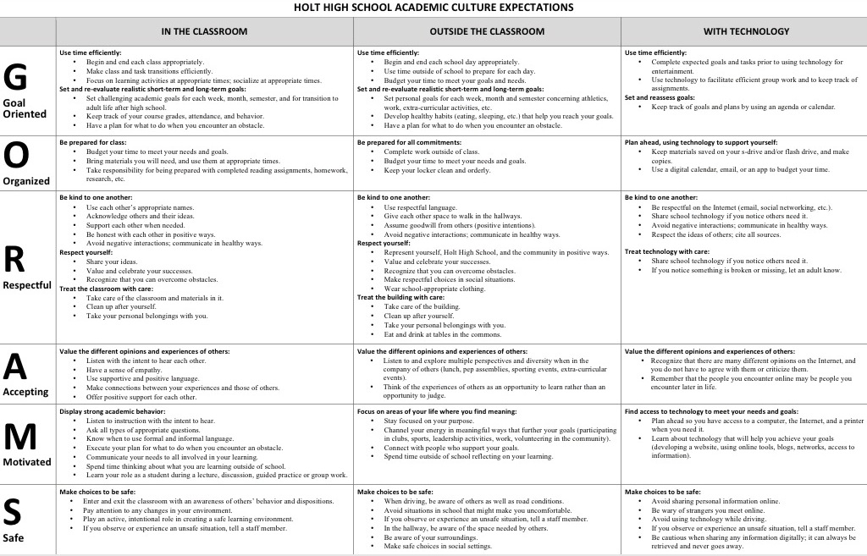
Academic Culture at HHS

Slide 4
PROMOTING AN ACADEMIC CULTURE OF SUCCESS
Regular attendance is key! Those that miss more than 10% of classes are less successful (9 days a semester)
Advocate for yourselves. Check Skyward regularly, ask for help, take ownership of your learning, create goals for yourself, and make connections with your learning outside of class.
Come to class with the attitude to learn and participate.
Take rigorous courses that challenge you.
Credits count toward graduation (must earn 22 credits out of 24). 9th grade is the beginning of HS transcript.
Students earn 3 credits per semester for a total of 6 per year. Each class is .5 credit.

Slide 5
PSAT
9-10th
  PSAT- April 11th

Slide 6
Parent Student Resources
Parent Student Academic Resources
Kahn Academy

Slide 7
Extra Curricular Activities
High School Sports (must be passing 4 of 6 classes)
High School Theatre (Plays and musicals)
Clubs offered 9-12
  Forensics
  Debate
  Science Olympiad
  Animee’
  Student Council
  Tech Society
  PALS
  TATU
  Ping Pong
  GSA
  *** National Honor Society; apply as a sophomore

Slide 8
Holt Graduation Requirements:
Class of 2020 & 2021
English 7 semesters
Math 7 semesters
Science 6 semesters
Social Studies 6 semesters
P.E./Health 2 semesters (1 P.E. & 1 Health)
Fine Arts 1 semester
Online experience 1 semester
Modern Language 4 semesters (2 years) *
  = 34 semesters total out of 48 possible

Slide 9
Grad Requirements
22 CREDITS NEEDED FOR GRAD
9
10
11
12
1 | 2
Hist | Hist
E. Sc | E. Sc
Eng | Eng
Geom | Geom
PE
1 | 2
Alg I | Alg I
W.H. | W.H.
Bio | Bio
Eng | Eng
Health | Art
1 | 2
Eng 11 | Eng 11
Alg II | Alg II
Gov | Comp
Chem/Phys | Chem/Phys
Spanish I | Spanish I
1 | 2
M.R | Eng Rel
Econ
Span II | Span II
holtguidanceandcounseling.weebly.com

Slide 10
9th Grade
Opportunity to have a grade/class within a wing of the building within the core classes.
National trend is to have a more focused and smaller learning community for freshman.
Portfolio presentations in May.
All students will update their EDP and 4 year plan www.careercruising.com
  Username: holt
  PW: rams

Slide 11
Scheduling process

Slide 12
Incoming 9th Grade Scheduling Dates
Day 1- February 7th during intervention
Day 2- February 8th
  Counselors will visit classrooms
  Schedule forms are due on Feb 15th.

Slide 13
9th Grade: Core Classes
U.S. History 1900-present 2 sem
  American Studies (SS/Eng)
Geometry (Honors teacher sig) 2 sem
English 9 (Honors App) 2 sem
Earth Science 2 sem
        = 8 out of 12 possible in a year

Slide 14
Course Request Sheet

Slide 15
9th Grade Electives
One Semester- SAMPLE!!!
  Dramatic Performance & Theatre - English elective
  Computer Applications - fulfills computer credit
  Drawing - fulfills fine art credit
  Painting - fulfills fine art credit
  Lifetime Activities - fulfills PE credit
  Health -graduation requirement
  ***as well as many other electives listed in Program Planning Manual
  Full Year
  Modern Language (German, Spanish, French)
  Concert Band
  Choir
  Technical Drawing A & B

Slide 16
 | Mock Freshman Schedule
 | Core with all electives
 | Semester One | Semester Two
1st Hour | Geometry A | Geometry B
2nd Hour | English 9 A | English 9 B
3rd Hour | U.S. History A | U.S. History B
4th Hour | Earth Science A | Earth Science B
5th Hour | Computer Apps | PE
6th Hour | General Art | Nutrition & Wellness

Slide 17
 |  | Mock Freshman Schedule
 | Core with Band and Modern Language
 | Semester One |  | Semester Two
1st Hour | Geometry A |  | Geometry B
2nd Hour | English 9 A |  | English 9 B
3rd Hour | U.S. History A |  | U.S. History B
4th Hour | Earth Science A |  | Earth Science B
5th Hour | Spanish II A |  | Spanish II B
6th Hour | Band A |  | Band B

Slide 18
Scheduling for next school year: Class of 2021
Honors application for English- March 3rd^{th} (portfolio – due in English class, summer reading). Talk to current English teacher for more information.
Teacher recommendation and parent approval for Honors Geometry; must sign course selection sheet.
Modern Language teacher initials approval to next level (e.g. Spanish II).
Schedule Request Form Due back to Math teachers on Feb 15th.

Slide 19
Incoming 10th grade
Opportunity to apply for Career Center.
Opportunity to apply for National Honor Society in February (3.25 GPA & 20 hours community service).
Opportunity to apply for Early College at LCC (March). Applications are mailed from LCC.
  More information forthcoming see Mr. Conner.
Opportunity to take first Advanced Placement course = A.P. World History & A.P. Biology.
All Course Applications due on Mar 3rd.

Slide 20
10th grade: Core Courses
World History (A.P. app) 2 semesters
Algebra A (Honors teacher rec)2 semesters
English 10 (Honors app) 2 semesters
Biology (A.P. app) 2 semesters
Applications due March 3rd.
_____________________________________ = 8 out of 12 possible in the year

Slide 21
Mock Sophomore schedule
 | Semester One |  | Semester Two
1st Hour | Algebra A |  | Algebra B
2nd Hour | Honors English 10 |  | Honors English 10
3rd Hour | World History A |  | World History B
4th Hour | Music Theory |  | Psychology
5th Hour | Biology |  | Biology
6th Hour | Computer Applications |  | Team Sports

Slide 22
Incoming 10th Grade Scheduling Dates
Day 1- February 7th
  Students walk through schedule and teachers discuss next year options.
Day 2- February 9th
  Counselors will visit classrooms
  Schedule forms are due on Feb 9th. (Same Day)

Slide 23
How do I make up credits
Summer School ($100) and Michigan Virtual High School are the options for making up credit when considered OFF TRACK for graduation. OFF Track = more than 2.0 credits of failure (5 classes)

Slide 24
Course Request Sheet

Slide 25
Scheduling for next year: Class of 2020
Overview of classes and electives presented 1st hour and throughout the day on Feb 9th. Students will have a notes sheet to carry with them.
Counselors in Math classes Feb. 9th ; schedule request forms due that day. A confirmation letter will be sent home and must be returned with parent signature.
Honors Algebra I requests should be made to student’s current Math teacher. Teachers provide counselors with list of approved students.
Application process for Honors English 10. Due March 3rd.

Slide 26
Biggest student scheduling mistakes/conflicts
Not turning in your request sheet
Not turning in your request sheet on time
Not turning in your registration confirmation sheet, with signature
Multiple single offering courses.

Slide 27
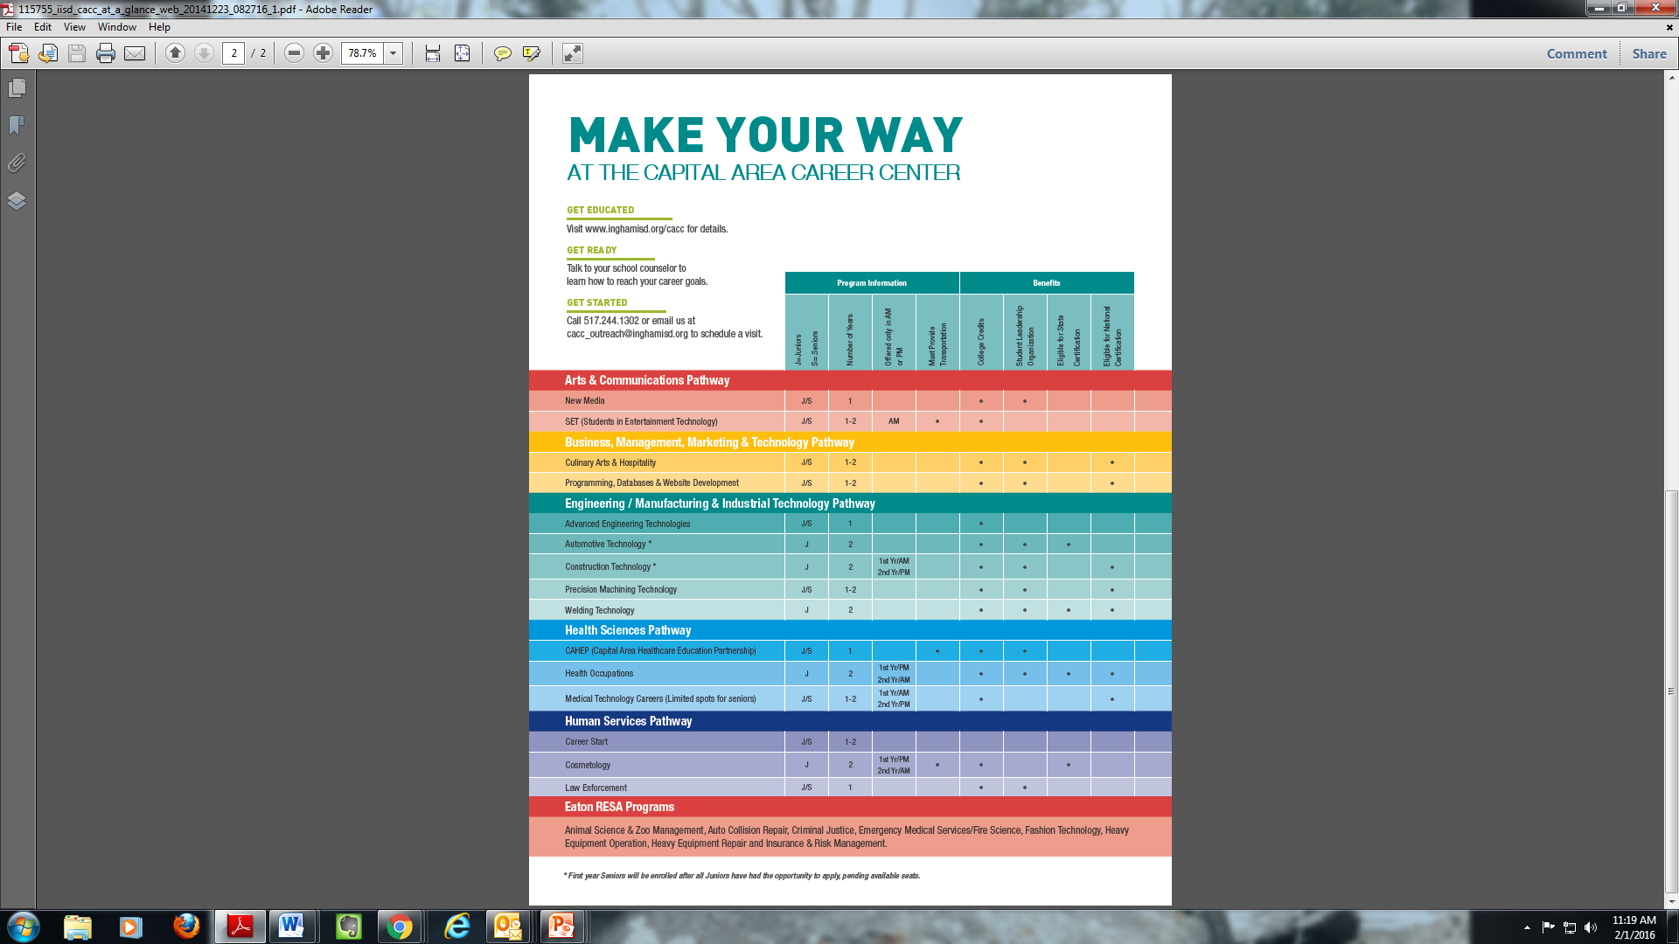
CACC

Slide 28
Support Systems:
Every student will create an Educational Development Plan (EDP); www.careercruising.com username-holt; password-rams
Portfolio Days first full week in May (9th grade)
Peer Mentors- Tutoring in library Mondays- 2:45-3:45
Success Coordinators
  Mrs. Lewicki

Slide 29
What to do now:
Talk with your current teachers to discuss what courses and levels to take.
Prepare questions for counselors visit to classrooms.
Read the Program Planning Manual for a complete description of courses:
  www.holtguidanceandcounseling.weebly.com

Slide 30
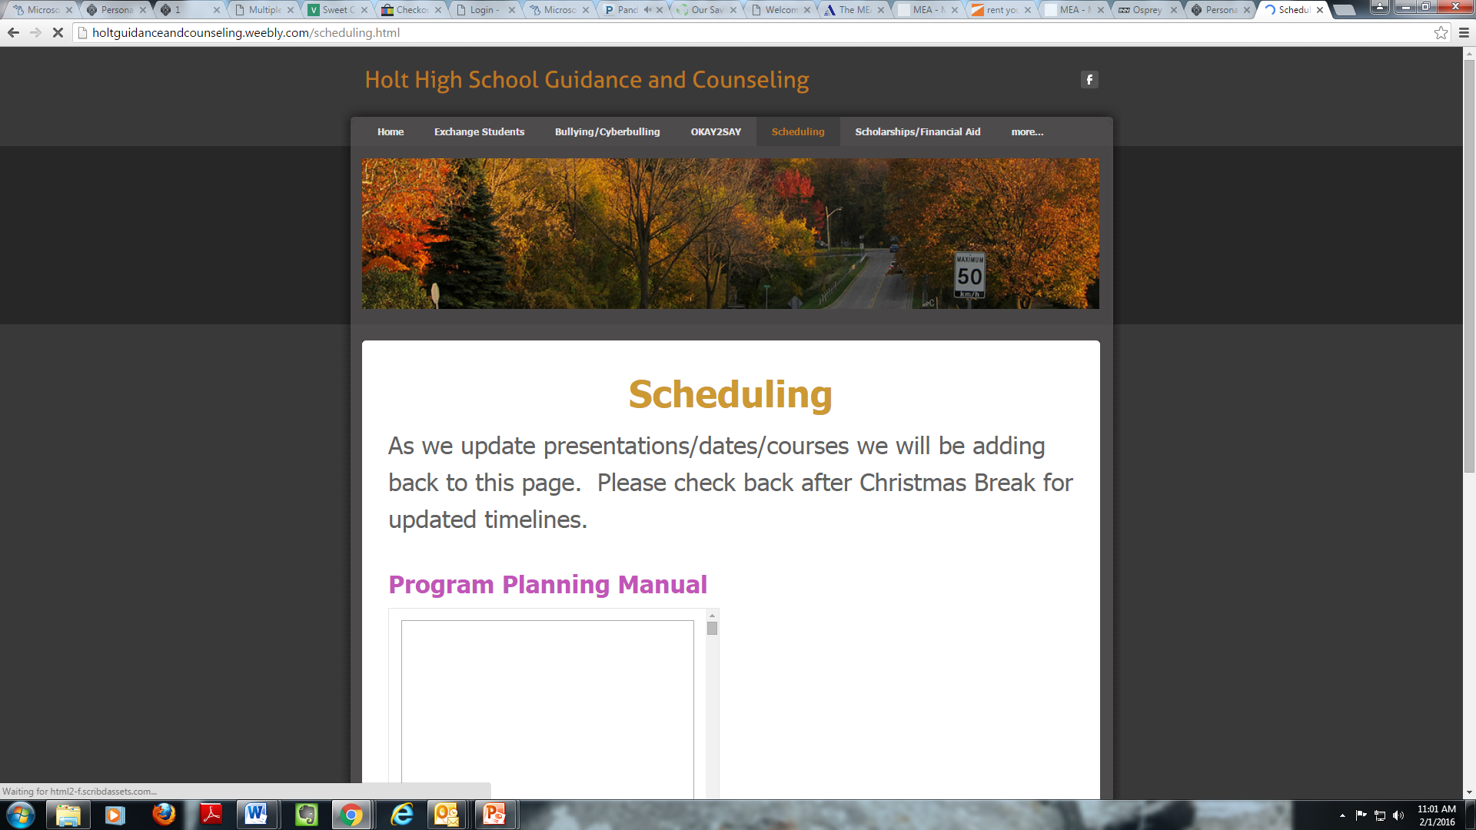
Guidance Website www.holtguidanceandcounseling.weebly.com

